Slide 1
SCADA TRAINING
Field Instruments & Sensors
AJAY K BASU
akbasu48@gmail.com

Slide 2
Field Equipment Standards
IEEE 488 GPIB, IEC 61158 – Fieldbus
IEC 60870-5, DNP
ElectroMagnetic Compatibity (EMC) IEC 61000
Enclosure Standard (IP) IEC 60529
Signal Cabling Standard (Cat 5 &6)

Slide 3
IEE – 488 GPIB - General Purpose Interface Bus
Originally developed in Hewlett Packard as Hewlett Packard Interface Bus (HPIB) to connect Controllers with the Instruments, the IEEE standardized the bus as Standard Digital Interface for Programmable Instrumentation, IEEE- 488. IEC developed a similar standard IEC 60625.
IEC 60488
Later in 2003, IEC and IEEE merged their standards IEC 60625 and IEEE – 488 to IEC 60488.
The IEEE- 488 interface bus, also known as the General Purpose Interface Bus is an 8 bit wide byte serial, bit parallel interface system which incorporates:
5 Control lines
3 Handshake lines
8 Bi-directional data lines

Slide 4
IEE – 488 GPIB - General Purpose Interface Bus
The maximum data transfer rate is determined by a number of factors, but is assumed to be 1Mb/s.
Devices exist on the bus in any one of 3 general forms:
1. Controller
2. Talker
3. Listener
A single device may incorporate all three options, although only one option may be active at a time. The Controller makes the determination as to which device becomes active on the bus. The GPIB can handle only 1 ‘active’ controller at a time on the bus, although it may pass operation to another controller. Any number of active listeners can exist on the bus with an active talker as long as no more than 15 devices are connected to the bus.

Slide 5
IEC 61158 - Fieldbus
IEC 61158 covers a family of Fieldbus protocols, which are listed below.
Foundation fieldbus H1
ControlNet
Profibus- DP, PA
P-Net
Foundation Fieldbus HSE (High Speed Ethernet)
Swiftnet
WorldFIP
Interbus-S
IEC 61158 defines Physical Layer specification and service definition, Data Link Service definition, Data Link Protocol specification, Application Layer Service definition and Application Layer Protocol specification. We discuss here general characteristics of Fieldbus and two of the most popular Fieldbus Protocols – Fieldbus Foundation and Profibus.

Slide 6
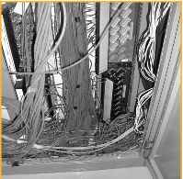
Fieldbus Foundation
Trunk or Segment
Instruments produce 4-20mA output signal that travels from Field Instrument to Controller. Similarly, 4-20mA control signals travel from controller to the Field Instrument. Consequently, Hundreds, sometimes thousands, of cables snake their way through cable trays, termination racks, cabinets, enclosures and conduit.
The availability of low cost, powerful processors suitable for field instrumentation now opens the way to remove the bulk of these cables and, at the same time, enhance data available from the plant.

Slide 7
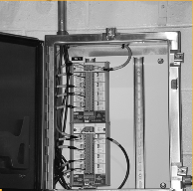
Fieldbus Foundation
Instead of running individual cables, fieldbus allows multiple instruments to use a single cable, called a “trunk” or a “segment,” (Fig. 6); each instrument connects to the cable as a “drop.” Instruments, of course, must have a fieldbus interface to connect to the segment, and some sort of software running to provide the fieldbus communications.

Slide 8
IEC 60870-5
The IEC Technical Committee 57 (Working Group 03) have developed a protocol standard for telecontrol, teleprotection, and associated telecommunications for electric power systems. The result of this work is IEC 60870-5. Five documents specify the base IEC 60870-5:
IEC 60870-5-1 Transmission Frame Formats IEC 60870-5-2 Data Link Transmission Services IEC 60870-5-3 General Structure of Application Data IEC 60870-5-4 Definition and Coding of Information Elements IEC 60870-5-5 Basic Application Functions IEC 60870-5-6 Guidelines for conformance testing for the IEC 60870-5 companion standards IEC TS 60870-5-7 Security extensions to IEC 60870-5-101 and IEC 60870-5-104 protocols

Slide 9
Distributed Network Protocol
The development of DNP3 was a comprehensive American effort to achieve open, standards-based Interoperability between substation computers, RTUs, IEDs (Intelligent Electronic Devices) and master stations (except inter-master station communications) for the electric utility industry. Also important was the time frame; the need for a solution to meet today's requirements. Since the inception of DNP, the protocol has also become widely utilized in adjacent industries such as water / waste water, transportation and the oil and gas industry.
DNP3 is based on the same standards of the International Electrotechnical Commission (IEC) Technical Committee 57, Working Group 03 who have been working on an OSI 3 layer "Enhanced Performance Architecture" (EPA) protocol standard for telecontrol applications.
DNP3 is an open and public protocol. In order to ensure interoperability, longevity and upgradeability of the protocol, the DNP3 Users Group has taken ownership of the protocol and assumes responsibility for its evolution. The DNP3 Users Group Technical Committee evaluates suggested modifications or additions to the protocol and then amends the protocol description as directed by the Users Group members.

Slide 10
Electromagnetic Compatibility EMC
IEC 61000
EMC describes the ability of electronic and electrical systems or components to work correctly when they are close together. In practice this means that the electromagnetic disturbances from each item of equipment must be limited and also that each item must have an adequate level of immunity to the disturbances in its environment.
IEC 61000 Part 1: General - Safety Function and Safety Integrity Requirement
IEC 61000 Part 2: Environment - Description, Classification and Compatibility Levels
IEC 61000 Part 3: Limits - Emission and immunity Limits
IEC 61000 Part 4: Testing and Measurement Limits
IEC 61000 Part 5: Installation and Mitigation Guidelines
IEC 61000 Part 6: Generic Standards
IEC 61000 Part 9: Miscellaneous

Slide 11
Standards for Enclosures
IEC 60529 & Ingress Protection (IP) -
SCADA equipments, particularly field instruments often have to work in open environment, with or without shelter. Hence the enclosure and its protection capability are very important.
Standardized by IEC 60529 and adopted by NEMA, Ingress Protection (IP) ratings are developed by the European Committee for Electro Technical Standardization (CENELEC). IP code specifies the Degree of Protection Provided by Enclosure.
The IP rating normally has two (or three) numbers:
Protection from solid objects or materials
Protection from liquids (water)
Protection against mechanical impacts (commonly omitted, the third number is not a part of IEC 60529)

Slide 12
Standards for Enclosures
First number - Protection against solid objects
0 No special protection
1 Protected against solid objects over 50 mm, e.g. accidental touch by persons hands
2 Protected against solid objects over 12 mm, e.g. persons fingers
3 Protected against solid objects over 2.5 mm (tools and wires)
4 Protected against solid objects over 1 mm (tools, wires, and small wires)
5 Protected against dust limited ingress (no harmful deposit)
6 Totally protected against dust

Slide 13
Standards for Enclosures
Second number - Protection against liquids
0 No protection
1 Protection against vertically falling drops of water e.g. condensation
2 Protection against direct sprays of water up to 15º from the vertical
3 Protected against direct sprays of water up to 60º from the vertical
4 Protection against water sprayed from all directions - limited ingress permitted
5 Protected against low pressure jets of water from all directions - limited ingress
6 Protected against temporary flooding of water, e.g. for use on ship decks - limited ingress permitted
7 Protected against the effect of immersion between 15 cm and 1 m
8 Protects against long periods of immersion under pressure

Slide 14
Standards for Enclosures
Example 1- IP 22
An electrical socket rated IP22 is protected against
solid objects over 12 mm - ex. insertion of fingers
direct sprays of water up to 15º from the vertical - ex. damage or unsafe due to vertically or nearly vertically dripping water
Example 2 - IP 54
With the IP rating IP 54, 5 describes protection from dust and from limited low pressure water spray
Example 3 - IP X1
"X" can be used for one of the digits if there is only one class of protection, i.e. IPX1 which addresses protection against vertically falling drops of water e.g. condensation.

Slide 15
Signal Cable Standards – Cat 5 & Cat 6
The specification for category 5 cable was defined in ANSI/TIA/EIA-568-A, with clarification in TSB-95. These documents specify performance characteristics and test requirements for frequencies up to 100 MHz Cable types, connector types and cabling topologies are defined by TIA/EIA-568-B
Nearly always 8 point 8 connector (8P8C) modular connectors (most often RJ45 connectors) are used for connecting category 5 cable. The cable is terminated in either the T568A scheme or the T568B scheme. The two schemes work equally well and may be mixed in an installation so long as the same scheme is used on both ends of each cable.
Each of the four pairs in a cat 5 cable has differing precise number of twists per meter to minimize crosstalk between the pairs. Although cable assemblies containing 4 pairs are common, category 5 is not limited to 4 pairs. Backbone applications involve using up to 100 pairs. This use of balanced lines helps preserve a high signal-to-noise ratio despite interference from both external sources and crosstalk from other pairs.
The specific category of cable in use can be identified by the printing on the side of the cable.

Slide 16
Signal Cable Standards – Cat 5 & Cat 6
Bending radius
Most Category 5 cables can be bent at any radius exceeding approximately four times the outside diameter of the cable.
Maximum cable segment length
The maximum length for a cable segment is 100 m per TIA/EIA 568-5-A.
If longer runs are required, the use of active hardware such as a repeater or switch is necessary.
The specifications for 10BASE-T networking specify a 100-meter length between active devices. This allows for 90 meters of solid-core permanent wiring, two connectors and two stranded patch cables of 5 meters, one at each end.

Slide 17
Signal Cable Standards – Cat 5 & Cat 6
Category 5e
The category 5e specifications improve upon the category 5 specification by tightening some crosstalk specifications and introducing new crosstalk specifications that were not present in the original category 5 specifications. The bandwidth of category 5 and 5e is the same (100 MHz) and the physical cable construction is the same, and the reality is that most Cat 5 cables meet Cat 5e specifications, though it is not tested or certified as such
Category 6
The category 6 specifications improve upon the category 5e specification by improving frequency response, tightening crosstalk specifications, and introducing more comprehensive crosstalk specifications. The improved performance of Cat 6 is 250 MHz and supports 10GBASE-T (10-Gigabit Ethernet).

Slide 18
Applications of Cat 5/6 cables
This type of cable is used in structured cabling for computer networks such as Ethernet over twisted pair. The cable standard provides performance of up to 100 MHz and is suitable for 10BASE-T, 100BASE-TX (Fast Ethernet), and 1000BASE-T (Gigabit Ethernet).
10BASE-T and 100BASE-TX Ethernet connections require two wire pairs. 1000BASE-T Ethernet connections require four wire pairs.
Through the use of power over Ethernet (PoE), up to 25 watts of power can be carried over the cable in addition to Ethernet data.
Cat 5 is also used to carry other signals such as telephony and video.

Slide 19
Applications of Cat 5/6 cables
This type of cable is used in structured cabling for computer networks such as Ethernet over twisted pair. The cable standard provides performance of up to 100 MHz and is suitable for 10BASE-T, 100BASE-TX (Fast Ethernet), and 1000BASE-T (Gigabit Ethernet).
10BASE-T and 100BASE-TX Ethernet connections require two wire pairs. 1000BASE-T Ethernet connections require four wire pairs.
Through the use of power over Ethernet (PoE), up to 25 watts of power can be carried over the cable in addition to Ethernet data.
Cat 5 is also used to carry other signals such as telephony and video.

Slide 20
Some desirable features of field equipments
Field equipments work in open environment. Hence the following features are desirable:
Ambient temperature , Relative humidity, Altitude and wind speed tolerance should be well above the expected maximum variation in the site of installation
Power input: Should be able to operate on solar powered DC for a long time (say 30 days) without necessity of charging.

Slide 21
Some desirable features of field equipments
Enclosure standard of (e.g. IP 65) according to environment
Electromagnetic compatibility certification (EMC) or FCC or country-specific certification
Conforming to open communication standard

Slide 22
Reservoir/Canal Automation related field equipments
Gate control
Gate position monitoring
Water level Measurement
Open channel profiling and water flow measurement
Weather Station
Others

Slide 23
Gate Control
Usually gate is controlled by DC/AC motor with a series of gears for reducing speed.
- For large gates 3-phase AC motor with phase reversal is used for moving the gate forward or reverse (up/down)
- For smaller gates DC motor is used

Slide 24
Gate Control
Usually gate is controlled by DC/AC motor with a series of gears for reducing speed.
- For large gates 3-phase AC motor with phase reversal is used for moving the gate forward or reverse (up/down).
- For smaller gates DC motor is used
- Though on/off logic control for gate movement is most common,
PID control and predictive control (MPC) are also used, particularly for networked canal gates.

Slide 25
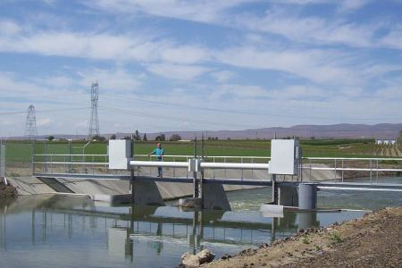
GATE CONTROL
Gate Size
12 ft (3.7m) x 8.5 ft (2.6m); 6.6 ft (2.0m) of movement
Drive Train
½ HP – 24 Vdc motor. Helical worm speed reducer. Roller chain in omega configuration. Rising masts.
Gate Speed
4.0 inches/min. (100 mm/min.)

Slide 26
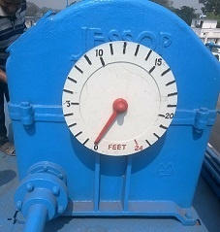
GATE CONTROL
Gate Size
60 ft x 18 ft ; 24 ft of movement
Drive
5HP 3-phase AC. Speed reduction by a series of gears to drive the drum on which rope holding gate in wound. The photograph shows
Dial indicating gate position
Gate Speed
About 1.0 ft/min.

Slide 27
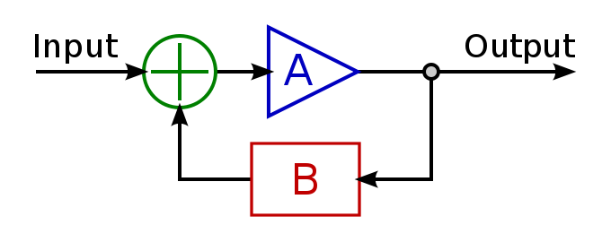
Feed-Back Control System
Basic Feed-Back Control

Slide 28
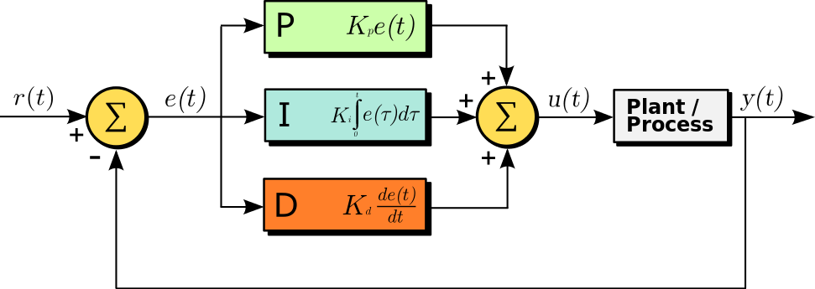
PID Control System

Slide 29
ON/OFF Control
As its name implies, On-Off Control assigns the Controller Output (CO) to one of two positions such that the final control element (FCE) is either fully open or fully closed. Unlike intermediate value or PID control, there is no in between. Most industrial processes require greater latitude when it comes to adjusting the COs position.

Slide 30
Digital Control

Slide 31
Logic Control
Logic control uses digital electronics and programming for implementation
Logic gates, microprocessors/microcontrollers and sometimes complete computer systems are building blocks for implementing control logic.
Special languages or notations like ladder logic are used in Programmable Logic Controllers
Modern systems use tools and applications based on standard computer languages like C/C++/JAVA
Control using fuzzy logic considers in-between values between true (1) and false (0). Fuzzy logic is based on the basis of a measurement being partially true.

Slide 32
Gate Position Sensing
Simplest way to monitor gate position is to measure angle of rotation.
Optical Encoders fitted on the main drive shaft is a commonly used sensing arrangement.
Absolute encoder is suitable for measurement of small angles. Incremental encoder can be used for high speed rotation.

Slide 33
Modern Sensors
Modern Sensors are characterized by:
Extreme low size
Low price
Probably the most dramatic recent progress in the sensor technologies relates to wide use of
MEMS (micro-electro-mechanical systems and
MEOMS (micro-electro-opto-mechanical systems)

Slide 34
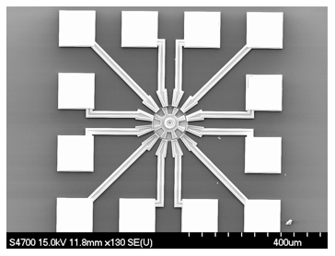
MEMS Motor
A surface micromachined electro-statically-actuated micromotor. This device is an example of a MEMS-based microactuator.

Slide 35
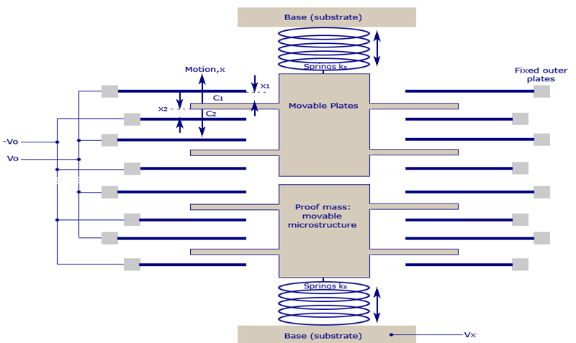
MEMS Accelerometer
MEMS Accelerometer

Slide 36
Sensor Communication
Modern sensors connect with the external world through various standard interfaces and protocols. SDI – 12 is the most popular one. Few common protocols are:
SDI-12 (Serial Digital Interface at 1200 baud)
SPI
I²C Protocol
1-Wire protocol

Slide 37
SDI - 12
SDI-12 (Serial Digital Interface at 1200 baud):
An asynchronous serial communications protocol for intelligent sensors that monitor environment data.
Instruments are typically low-power (12 volts), are used at remote locations, and usually communicate with a data logger or other data acquisition device.
The protocol follows a master-slave configuration whereby a data logger (SDI-12 recorder) requests data from the intelligent sensors (SDI-12 sensors), each identified with a unique address.

Slide 38
SPI
Serial Peripheral Interface bus (SPI) is a synchronous serial communication interface specification used for short distance communication, primarily in embedded systems. The interface was developed by Motorola in the late eighties and has become a de facto standard.
SPI devices communicate in full duplex mode using a master-slave architecture with a single master. The master device originates the frame for reading and writing. Multiple slave devices are supported through selection with individual slave select (SS) lines..

Slide 39
I²C Protocol
The Inter-integrated Circuit (I²C) Protocol is a protocol intended to allow multiple “slave” digital integrated circuits (“chips”) to communicate with one or more “master” chips. Like the Serial Peripheral Interface (SPI), it is only intended for short distance communications within a single device.
I²C uses only two bidirectional open-drain lines, Serial Data Line (SDA) and Serial Clock Line (SCL), pulled up with resistors. Typical voltages used are +5 V or +3.3 V although systems with other voltages are permitted.

Slide 40
1 - Wire Protocol
1-Wire is a device communications bus system designed by Dallas Semiconductor Corp. that provides low-speed data, signaling, and power over a single conductor.
1-Wire is similar in concept to I²C, but with lower data rates and longer range. It is typically used to communicate with small inexpensive devices such as digital thermometers and weather instruments. A network of 1-Wire devices with an associated master device is called a MicroLAN.
One distinctive feature of the bus is the possibility of using only two wires: data and ground. To accomplish this, 1-Wire devices include an 800 pF capacitor to store charge, and to power the device during periods when the data line is active.

Slide 41
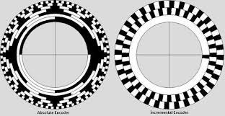
Absolute and Incremental Encoder

Slide 42
Incremental Encoder

Slide 43
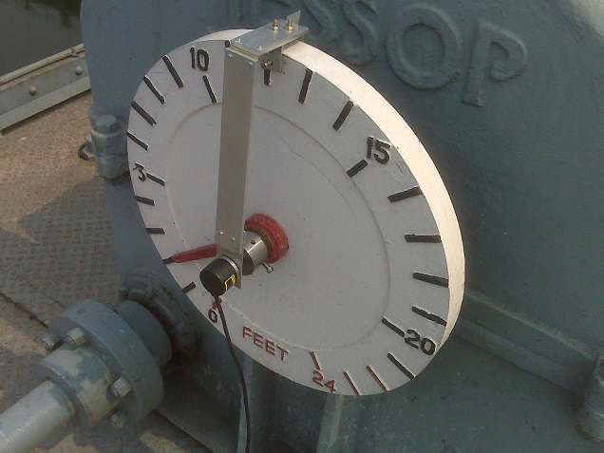
Optical Encoder
An optical encoder measuring angle of rotation of the main shaft
Accuracy: ± 0.5% of the full range

Slide 44
Water Level
For water level of a Reservoir or canal, a large number measuring/sensing systems exist. Often they are classified under the broad category of Digital Water Level Recorder (DWLR). A few sensing mechanisms are discussed here:
Non-Contact Pulse Radar – most accurate, most expensive
Ultrasonic - Reasonably priced lesser accuracy
3. Pressure sensing – reasonably priced, rugged with lesser accuracy. More suitable for borewells

Slide 45
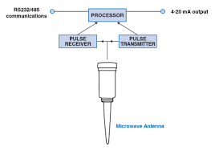
Pulse Radar
Typical specification:
Measurement Time 20 Sec (Max)
Measurement Range 2-30 meters
Accuracy ± 1 cm
Interfaces: Usually support SDI-12, RS 485, 4-20mA Current Loop

Slide 46
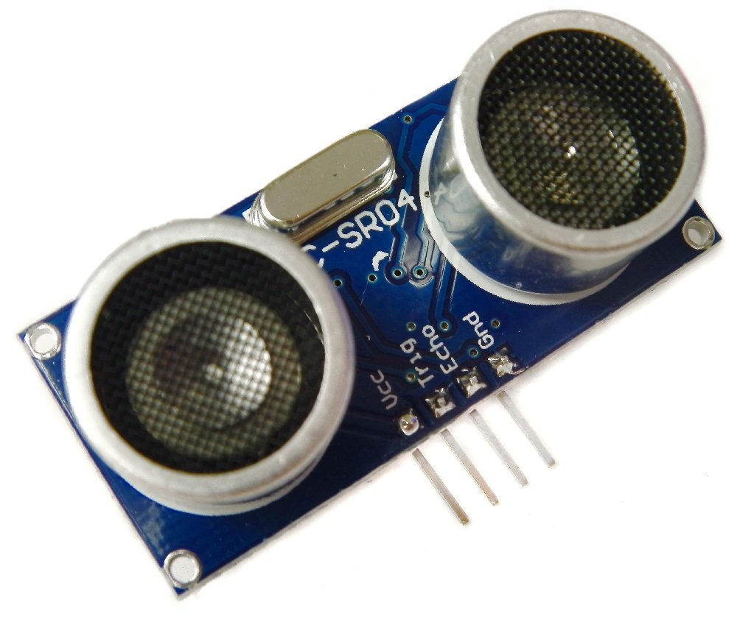
Ultrasonic
Operates on similar principle but uses ultrasonic waves.

Slide 47
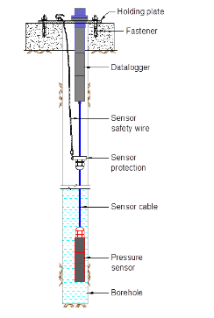
Pressure-based sensing

Slide 48
Data Logger
Data loggers are typically compact, battery-powered devices equipped with an internal microprocessor, data storage, and one or more sensors. They can be deployed indoors, outdoors, and underwater, and can record data for up to months at a time, unattended.

Slide 49
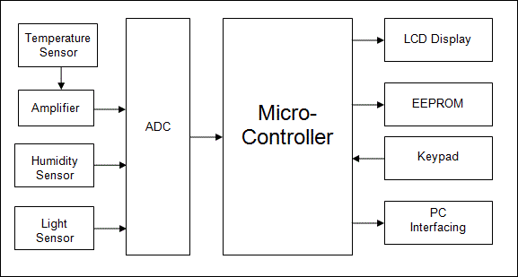
Data Logger

Slide 50
Modern Data Logger
Built-in wireless communication (GSM/GPRS)
Open design, operating with a wide variety of sensors.
Multi tasking operating system capable of simultaneous data collection and transmission.
windows plug and play device
Non-volatile Flash memory that can store data for long period
User defined recording intervals
User configurable alarms (triggering)
Monitoring of voltage level.
Internal clock
Protocols: Support TCP/IP
Interfaces: The SDI-12, RS-232 and other interface bus

Slide 51
INTELLIGENT WEATHER STATION

Slide 52
FEATURES
Cost-effective solution using state-of-the-art components and technologies
Modular Design - enables user to pick and choose building blocks
Embedded Weather Station Controller with on-line remote viewing capability (needs internet connectivity)
Basic configuration include Cup Anemometer, Wind Vane and Tipping Rain Bucket

Slide 53
ADDITIONAL FEATURES
System supports host of additional sensors including Barometric Pressure, Temperature, Humidity etc.
Battery Operated System with provision for solar powered charging with Sun-Tracking servo system
Atmospheric activity monitoring with Lightning Detection (Optional)
On-line Monitoring Software with GSM/Internet based alarm (requires internet/GSM connectivity)

Slide 54
Weather Rack
• Cup Anemometer
• Wind Vane
• Tipping Rain Bucket
• Mounting Hardware

Slide 55
Cup Anemometer
The Anemometer measures wind speed by closing a contact as a magnet moves past a switch. One contact closure a second indicates 1.492 MPH (2.4 km/h).

Slide 56
Wind Vane
The Wind vane has 8 switches, each connected to a different resistor
The Weather Rack measures the resistance value of the resistor
Typically, the Wind Vane will only report a total of 8 directions
It is possible to occasionally read 16 directions
Direction (Degrees) Resistance (Ohms)
0 33K
22.5 6.57K
45 8.2K
67.5 891
90 1K
112.5 688
135 2.2K
157.5 1.41K
180 3.9K
202.5 3.14K
225 16K
247.5 14.12K
270 120K
292.5 42.12K
315 64.9K
337.5 21.88K

Slide 57
Tipping Bucket Rain Gauge
The tipping bucket Rain Gauge used in the Weather Rack, makes one momentary contact closure that can be recorded with a micro computer interrupt input
Each contact closure of the standard unit indicates 0.011 inch (0.2794 mm) of rainfall

Slide 58
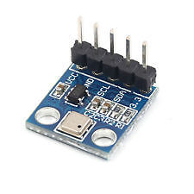
Atmospheric Pressure Sensor

Slide 59
Temperature Sensing Principles
Contact Temperature Types of temperature sensor are required to be in physical contact with the object being sensed and use conduction to monitor changes in temperature. They can be used to detect solids, liquids or gases over a wide range of temperatures.
Non-contact Temperature Sensor Types of temperature sensor use convection and radiation to monitor changes in temperature. They can be used to detect liquids and gases that emit radiant energy as heat rises and cold settles to the bottom in convection currents or detect the radiant energy being transmitted from an object in the form of infra-red radiation (the sun).

Slide 60
Temperature Sensors
Thermocouple
Bi-Metallic Thermostat
Thermisor
Thin-Film Resistive Temperature Detectors

Slide 61
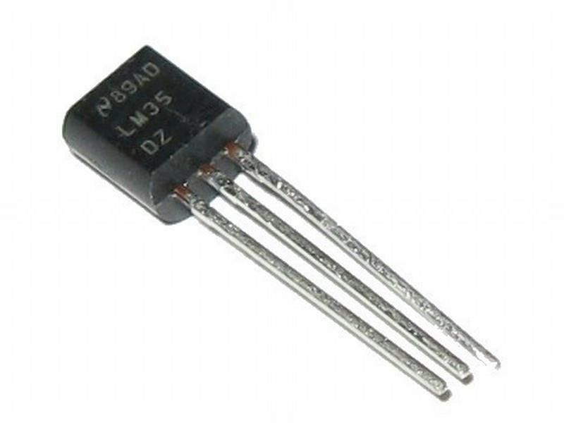
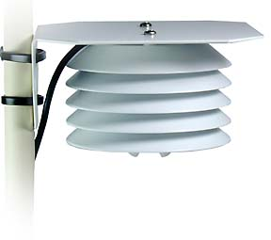
Temperature Sensor

Slide 62
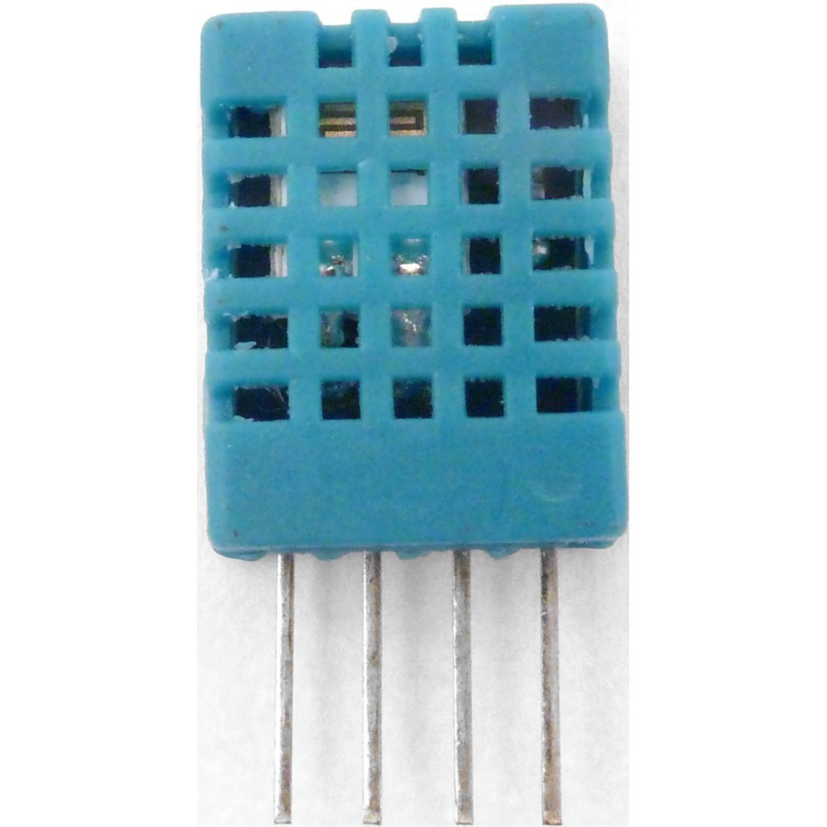
Humidity Sensor

Slide 63
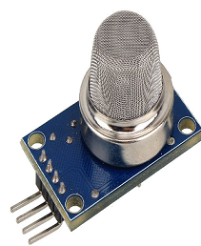
Pollution Sensors

Slide 64
Pollution Sensors
Common sensing element is SnO₂, which has lower conductivity in clean air.
When the target gas exist, The sensor’s conductivity is higher according to the gas concentration.

Slide 65
Pollution Sensors
H2
LPG
CH4
CO
alcohol
smoke
propane
air

Slide 66
Solar Power Controller
Typical Features
• 6V Solar Cells
• 3.7V LiPo Cells for batteries
• LiPo to 5V voltage boost built in
• Built-in current/voltage measurement
• Built-in ADC for Solar Tracking
• Built-in Interface for Servo motor or Stepper motor
• Approximates an MPPT (Maximum Power Point Tracking) charging system
Typical Solar Controller

Slide 67
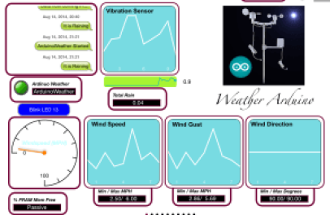
Software

Slide 68
ADCP
An Acoustic Doppler Current Profiler, or Acoustic Doppler Profiler, is often referred to with the acronym ADCP. Scientists use the instrument to measure how fast water is moving across an entire water column.
ADCP can be mounted horizontally on bridge pilings in rivers and canals to measure the current profile from shore to shore.

Slide 69
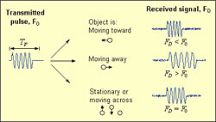
Doppler effect

Slide 70
Principle of operation
The ADCP works by transmitting "pings" of sound at a constant frequency into the water. As the sound waves travel, they ricochet off particles suspended in the moving water, and reflect back to the instrument.
Due to the Doppler effect, sound waves bounced back from a particle moving away from the profiler have a slightly lowered frequency when they return. Particles moving toward the instrument send back higher frequency waves. The difference in frequency between the waves the profiler sends out and the waves it receives is called the Doppler shift. The instrument uses this shift to calculate how fast the particle and the water around it are moving.
Sound waves that hit particles far from the profiler take longer to come back than waves that strike close by. By measuring the time it takes for the waves to bounce back and the Doppler shift, the profiler can measure current speed at many different depths with each series of pings.

Slide 71
ADCP
The ADCP works by transmitting "pings" of sound at a constant frequency into the water. As the sound waves travel, they ricochet off particles suspended in the moving water, and reflect back to the instrument.
Due to the Doppler effect, sound waves bounced back from a particle moving away from the profiler have a slightly lowered frequency when they return. Particles moving toward the instrument send back higher frequency waves. The difference in frequency between the waves the profiler sends out and the waves it receives is called the Doppler shift. The instrument uses this shift to calculate how fast the particle and the water around it are moving.
Sound waves that hit particles far from the profiler take longer to come back than waves that strike close by. By measuring the time it takes for the waves to bounce back and the Doppler shift, the profiler can measure current speed at many different depths with each series of pings.

Slide 72
ADCP in shallow water application
Should be able to measure near boundary surface or bottom accurately (side lobe interference)
Compass/2-axis tilt sensor
Typical frequency: 1 MHz
Profiling range: 0.5 – 25 m
Minimum Cell size: 0.25 m

Slide 73
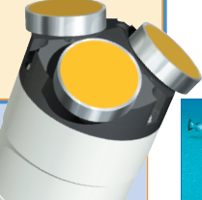
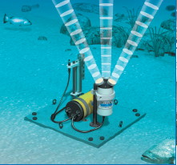
Multiple beams

